Slide 1
iGroup - Iteration 2
Team 6

Slide 2
Contents
Introduction
System Architecture
Database Design
Design Model – MVC
Demo

Slide 3
Introduction
iGroup
Replace manual grouping with survey
Integrate the answers included weight
Calculate the score for the assigned group
Swap the members until the best

Slide 4
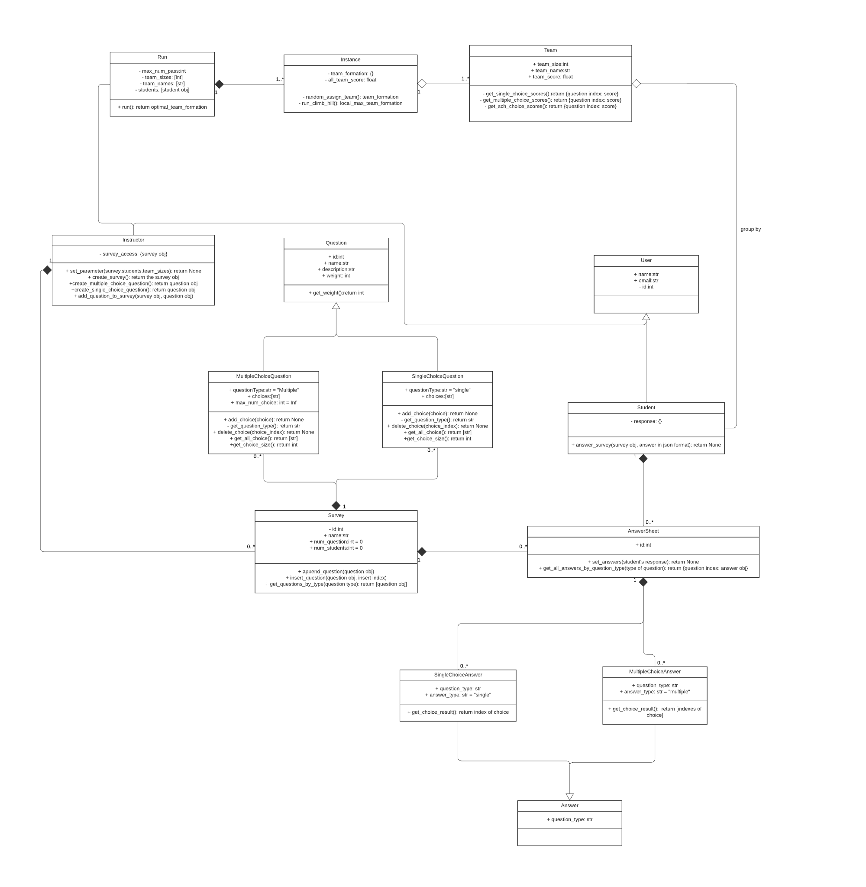
Class Diagram

Slide 5
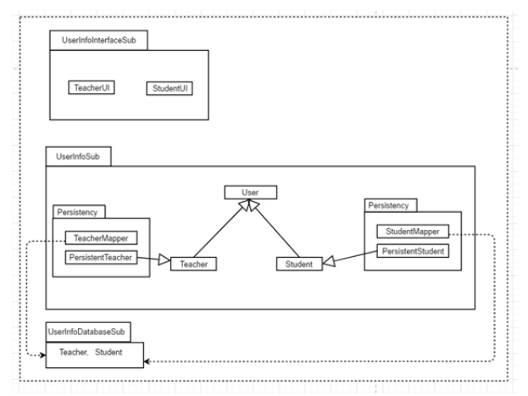
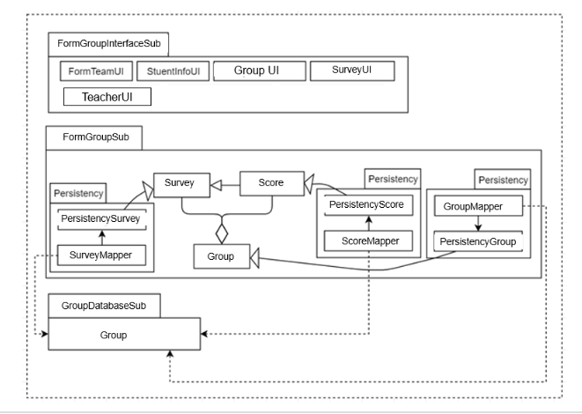
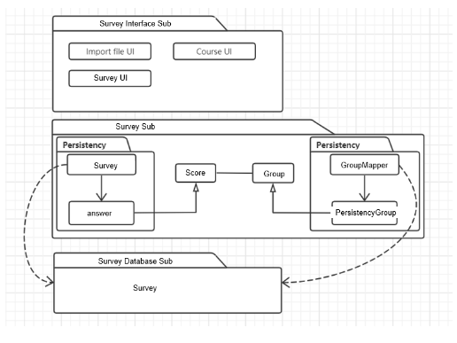
System Architecture

Slide 6
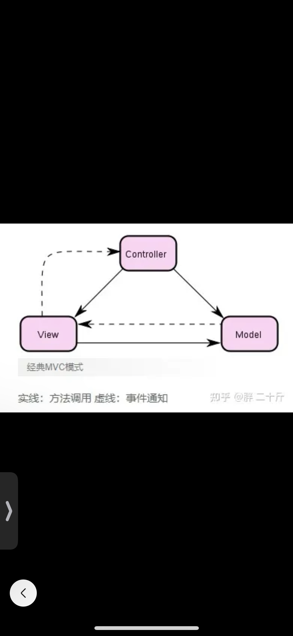
Design Model
We use MVC (Model-View-Controller) model in our system design because this system is an interactive system.
Uses a method of
separating business logic, data and interface
display to organize code, and gathers business
logic into a component.
Reduces the trouble of affecting the whole system due to changing some functions.
Makes the details easier and more efficient and the process of input, output and program processing into a visual way.

Slide 7
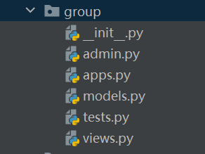
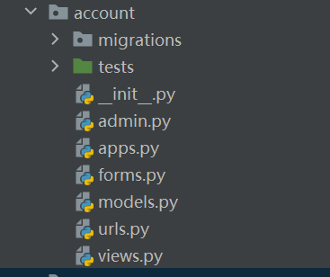
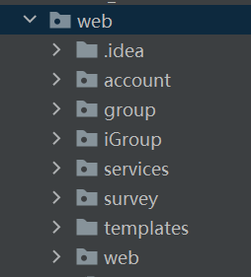
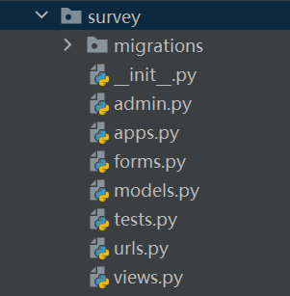
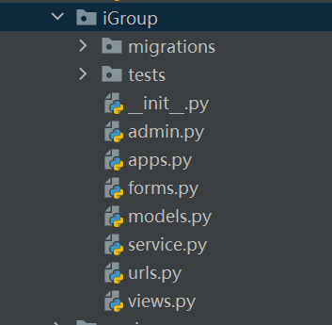
MVC in Django

Slide 8
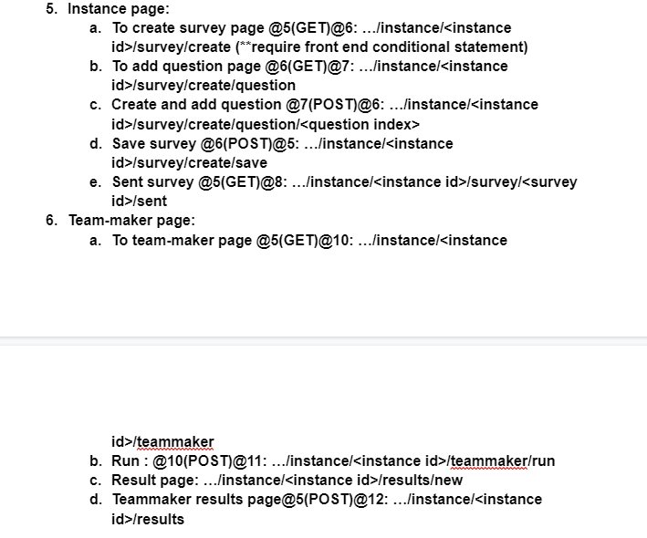
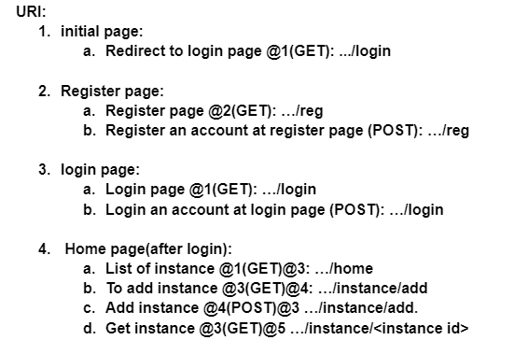
URL

Slide 9
Demo

